Slide 1




HACKGURU 2026
Organized by Kumaraguru College of Technology
&
Eclearnix Edtech LLC
Round 1
Chosen Hackathon Domain :
Domain 1 - AI-Driven Event Intelligence Platform Solution
Domain 2-
2.1 - AI Event Understanding & Classification Engine
2.2 - AI Personalized Event Recommendation System
2.3 - AI Smart Search & Discovery Assistant
2.4 - AI Event Quality & Verification Scanner
2.5 - AI User Engagement Enhancement
2.6- AI User Engagement Enhancement
Team Details :
  Team Name :FlashFive
  Domain Name :2.1 - AI Event Understanding & Classification Engine
  2.2 - AI Personalized Event Recommendation System
  2.5 - AI User Engagement Enhancement
  Single Point of Contact (SPOC) or Team lead Name :Raja Murugapappa
  SPOC Email ID : rajamurugappa1@gmail.com
  SPOC Mobile Number :6385908881

Slide 2
TEAM MEMBER’S NAMES & CONTACT DETAILS
S.no | Hackathon ID* | Team Member Name (*) | WhatsApp Contact Number | Role in the Hackathon (#) | Designation(Employee/ UG/ PG Student / etc) | College / Organization Name and Department State & Country
1. | HGURU0059 | Raja Murugappa | 63859 08881 | SPOC | UG Student | Kumaraguru COLLEGE OF TECHNOLOGY
2. | HGURU0059 | Aravind | 8248957895dd | Developer | UG Student | Kumaraguru college of Technology
3. | HGURU0059 | Navneeth | 99941 38347 | Debugger | UG Student | Kumaraguru College of Technology
4. | HGURU0059 | Thiyashini Ganesh | 9080883401 | Tester | UG Student | Kumaraguru College of Technology
5. | HGURU0059 | Sripal | 9791468285 | Research Analyst | UG Student | Kumaraguru College of Technology
(*) You will receive your Hackathon ID after completing registration and downloading the Eclearnix app. Click here to continue.
(#) - Project Leader, Research Analyst, Developer, Tester / Debugger, Documentation Lead , Presentation Lead, etc..

Slide 3








Website:
https://www.eclearnix.com
Website:
https://www.allcollegeevent.com

Slide 4
Problem Statements
2.1 — AI Personalized Event Recommendation System
Develop an AI-based recommendation system that analyzes student interests, preferences, and event interactions to recommend the most relevant college events to each student.
2.4 — AI User Engagement Enhancement
Develop AI-driven features such as personalized feeds, smart notifications, and re-engagement mechanisms to increase student participation in relevant events.

Slide 5
DOMAIN 2
AI-Driven Event Intelligence Platform Solution
2.1. AI Personalized Event Recommendation System
2.2. AI Smart Search & Discovery Assistant
2.3. AI Event Quality & Verification Scanner
2.4. AI User Engagement Enhancement
2.5. AI Organizer Intelligence Assistant
2.6. AI Token Consumption Meter & Cost Optimization Dashboard

Slide 6
Abstract & Domain Name
ABSTRACT
Problem Statement
Students often miss relevant hackathons, internships, workshops, and events because opportunities are scattered across platforms and recommendations are generic. Existing systems lack student-specific skill profiling, intelligent event understanding, and personalized discovery.
Objective / Aim
To develop ACE – AI-Powered College Event Intelligence Platform, an AI-driven personalized event discovery system that understands student capabilities and connects them with suitable opportunities.
Proposed Solution / Approach
ACE introduces a Personalized Skill Board that tracks student participation in hackathons, internships, events, workshops, and projects, continuously building a dynamic skill and activity profile. Two specialized AI agents power the system:
Recommendation Agent: Uses profile matching, semantic similarity, personalization, and ranking to recommend relevant opportunities.
Event Intelligence Agent: Uses Natural Language Processing (NLP), information extraction, event classification, domain tagging, and metadata analysis to create structured event profiles.
Both agents work together to perform AI-based student–event matching and generate personalized recommendations.
Expected Impact / Outcome
ACE aims to reduce information overload, improve event discovery, increase student engagement, and deliver context-aware recommendations aligned with individual skills, interests, experience, and career goals.
Keywords: Artificial Intelligence, NLP, Personalized Recommendation, Multi-Agent AI, Skill Profiling, Event Intelligence, Semantic Matching, Event Classification, Intelligent Search, Student Engagement.

Slide 7
Objective of the Project
OBJECTIVES OF THE PROJECT
Develop a Personalized Skill Board to track student participation, activities, skills, and achievements.
Build dynamic student skill profiles using academic activities, projects, hackathons, events, and GitHub contributions.
Analyze and understand events automatically using AI, NLP, classification, and domain extraction.
Implement a Recommendation Agent to match individual student profiles with relevant opportunities.
Implement an Event Intelligence Agent to convert raw event information into structured event profiles.
Provide personalized recommendations based on skills, interests, experience, career goals, and eligibility.
Continuously improve recommendations using student interactions, participation, and feedback.
Increase student engagement by helping students discover relevant academic and career opportunities efficiently.

Slide 8
Solution Design & Innovation
SOLUTION DESIGN & INNOVATION
Solution Design :
GITHUB : https://github.com/Aravind-S-21/ace.git
Personalized Skill Board: Maintains a dynamic profile of student skills, activities, participation, and achievements.
Event Intelligence Agent: Converts raw event descriptions into structured information such as domain, skills, category, eligibility, and target audience.
Recommendation Agent: Matches student profiles with event profiles and ranks the most relevant opportunities.
AI-Based Matching: Combines skills, interests, experience, career goals, and eligibility for personalized recommendations.
Continuous Learning: Student interactions and participation update the skill profile and improve future recommendations.
Innovation :
Two-Agent AI Architecture: Separates event understanding from student-specific recommendation for better specialization.
Dynamic Skill Evolution: The student profile continuously evolves based on real-world participation.
Context-Aware Recommendations: Moves beyond generic event listings to recommendations tailored to individual needs.
Explainable Recommendations: Shows why an event is relevant based on the student’s skills and interests.
Closed-Loop Intelligence: Activity → Skill Update → Better Matching → Better Recommendations, creating continuous personalization.

Slide 9
Solution Workflow / Approach
Student Onboarding
Register → Profile → Interests & Career Goals
↓
Personalized Skill Board
Activities + Hackathons + Events + Projects + GitHub
↓Student Onboarding
Register → Profile → Interests & Career Goals
↓
Personalized Skill Board
Activities + Hackathons + Events + Projects + GitHub
↓
Student Intelligence
Skill Extraction → Student Skill Profile
↓
Event Intelligence Agent
Raw Event Data → NLP Analysis → Event Profile
↓
Recommendation Agent
Student Profile + Event Profile → Matching → Ranking
↓
Personalized Recommendations
Relevant Events → Student Participation
↓
Feedback Loop
Participation → Skill Update → Improved Recommendations
Student Intelligence
Skill Extraction → Student Skill Profile
↓
Event Intelligence Agent
Raw Event Data → NLP Analysis → Event Profile
↓
Recommendation Agent
Student Profile + Event Profile → Matching → Ranking
↓
Personalized Recommendations
Relevant Events → Student Participation
↓
Feedback Loop
Participation → Skill Update → Improved Recommendations
Student Data → Student Profile → Skill Representation
Event Data → Event Intelligence → Structured Event Profile
Student Profile + Event Profile → AI Matching → Recommendation Score
User Interaction → Feedback Data → Profile Update

Slide 10
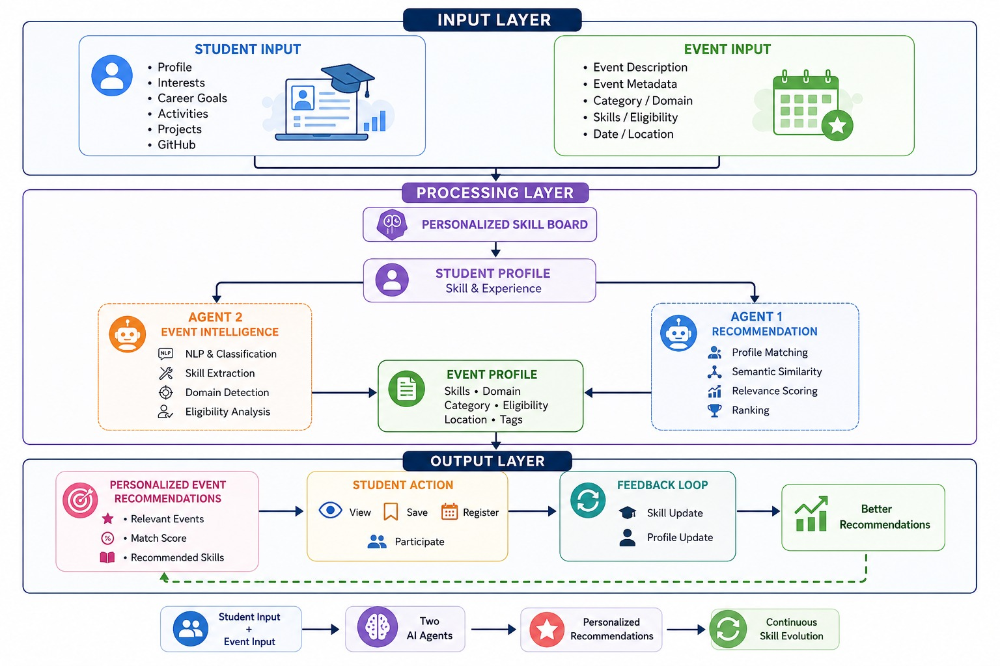
Architecture Diagram

Slide 11
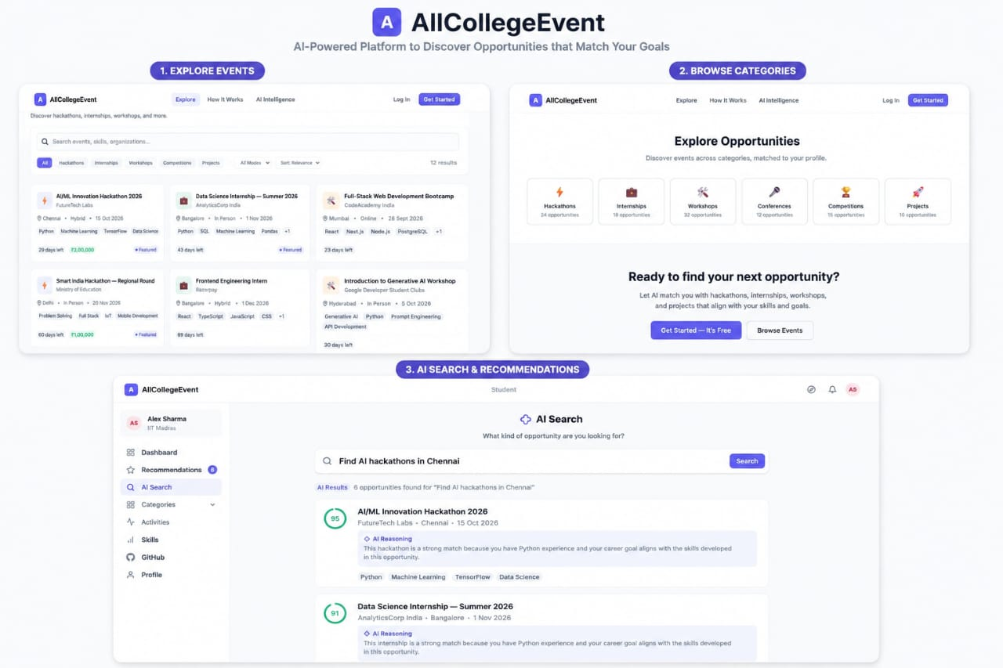
Prototype / UI Screens

Slide 12
Conclusion & Thank You
CONCLUSION
ACE – AI-Powered College Event Intelligence Platform provides a smarter and personalized way for students to discover relevant opportunities. The Personalized Skill Board continuously tracks student activities, skills, and participation, while the Event Intelligence Agent understands and structures event information. The Recommendation Agent then matches student profiles with suitable events and delivers personalized recommendations.
Through continuous feedback and skill updates, ACE improves recommendations over time. The system reduces information overload, increases student engagement, and helps students discover opportunities aligned with their skills, interests, experience, and career goals.
Student Profile + Event Intelligence + AI Recommendation → Smarter Opportunities

